Slide 1
Fundamentals
Special Thanks to
Nakib Hayat Chowdhury Sir

Slide 2
Structure of C Program
A C program basically consists of the following parts:
Preprocessor Commands
Functions
Variables
Statements & Expressions
Comments

Slide 3
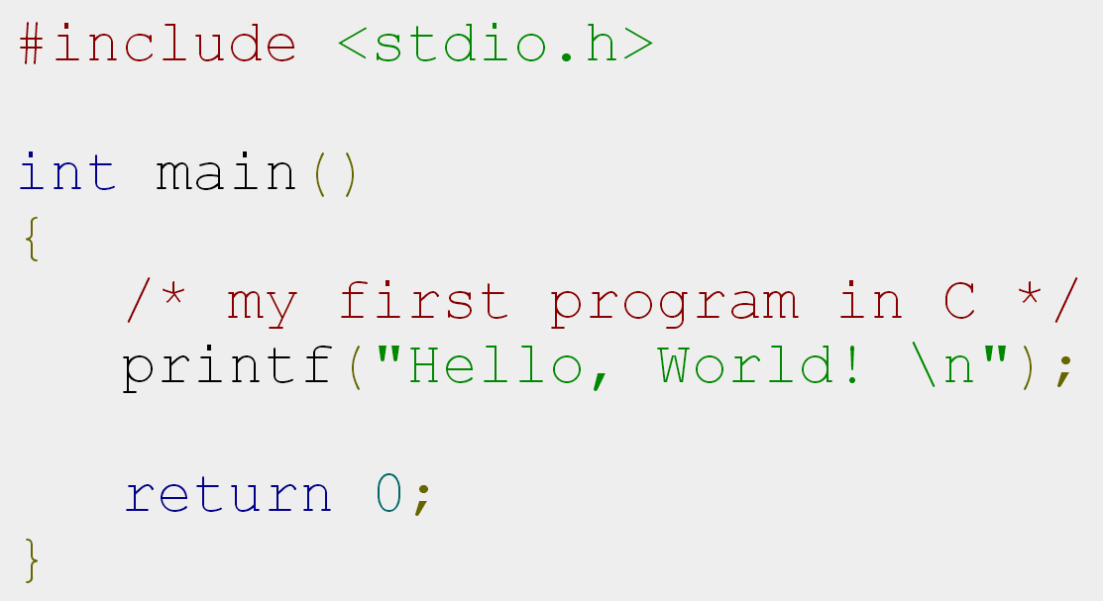
Structure of C Program
Preprocessor Commands
Main Function
Comment
Library Function
End of Program

Slide 4
Preprocessor Commands
These commands tells the compiler to do preprocessing before doing actual compilation.
Like #include <stdio.h> is a preprocessor command which tells a C compiler to include stdio.h file before going to actual compilation.

Slide 5
Functions
Functions are main building blocks of any C Program.
Every C Program will have one or more functions and there is one mandatory function which is called main() function.
The C Programming language provides a set of built-in functions.
In the above example printf() is a C built-in function which is used to print anything on the screen.

Slide 6
Comments
Comments are used to give additional useful information inside a C Program.
All the comments will be put inside /*...*/ as given in the example above.
A comment can span through multiple lines.
/* comment for multiple line */
// single line comment

Slide 7
Variable and Variable Declaration
Variable is a named memory location that can hold various values.
All variables must be declared before they can be used.
When we declare a variable, we tell the compiler what type of variable is being used.
A declaration associates a group of variables with a specific data type.

Slide 8
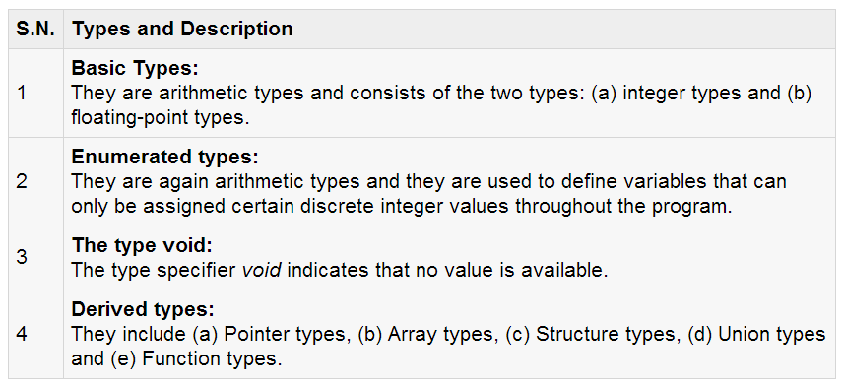
C’s Fundamental Data Type

Slide 9
C’s Basic Data Type
Type | Keyword | format Specifier | Memory Requirements
Character data | char | %c | 1 Byte
Signed whole numbers | int | %d | 2 or 4 Byte
Floating-point numbers | float | %f | 4 Byte
Double-precision floating-point number | double | %lf | 8 Byte
valueless | void |  | ---

Slide 10
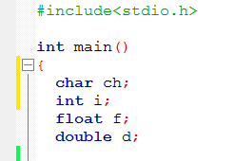
How to Declare Variables
To declare a variable, use this general form:
type var-name;
In C, a variable declaration is a statement and it must end in a semicolon (;).

Slide 11
Variable
Variables consist of letters and digits, in any order, except that the first character must be a letter.
Both upper-and lowercase letters are permitted, though common usage favors the use of lowercase letters for most types of variables.
Upper- and lowercase letters are not interchangeable (i.e., an uppercase letter is not equivalent to the corresponding lowercase letter.)

Slide 12
Variable (cont.)
The underscore character (_) can also be included, and is considered to be a letter.
An underscore is often used in the middle of an variable.
A variable may also begin with an underscore, though this is rarely done in practice.

Slide 13
Variable (cont.)
Case-sensitive
COUNT and count are not same
As a rule, an identifier should contain enough characters so that its meaning is readily apparent.
On the other hand, an excessive number of characters should be avoided.

Slide 14
Variable (Cont.)
Can not Use blank space
Can not Use any keyword
Can use letter of alphabet (A-Z, a-z)
Variable
The first character must be a letter
Digits (0-9)
Can not start a variable name with digit
Underscore (_)
Dollar sign ($)

Slide 15

Is it Valid Variable Name?
Apon
1joty
joty-5
apon
apon123
this_is_a_long_name
_sojeb_1
VaReNdRa

Slide 16
Is it Valid Variable Name?
4th
The first character must be letter
“x”
Illegal characters (“)
Order-no
Illegal characters (-)
My variable
Illegal characters (blank space)

Slide 17
Where to Declare?
There are three places where variables are declared:
Inside a function (local variable)
Outside all functions (global variable)
As function’s parameter

Slide 18
Identifiers
Identifiers are names that are given to various program elements, such as variables, functions and arrays.

Slide 19
Keywords
There are certain reserved words, called Keywords, that have standard, predefined meaning in C
Can be used only for their intended purpose
Can't use as identifiers

Slide 20
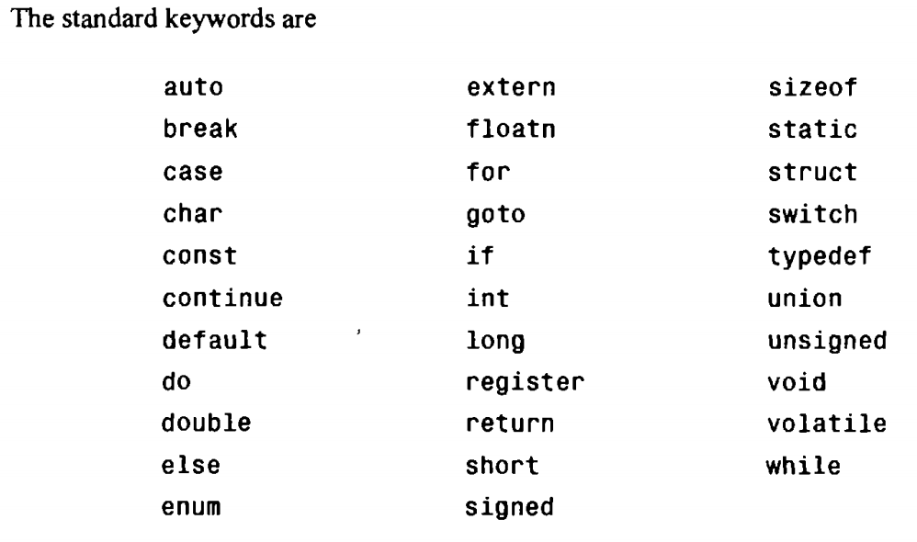
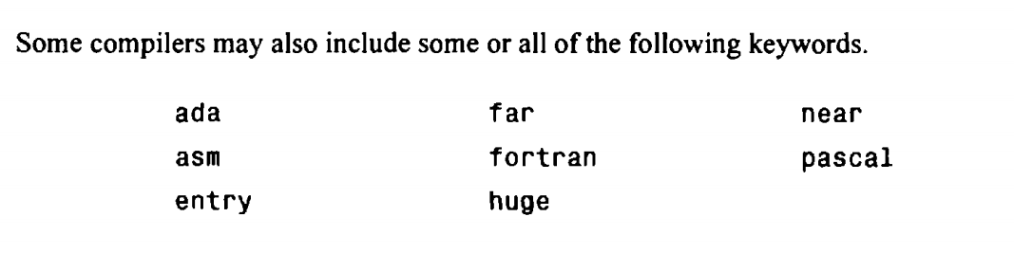
Keywords

Slide 21
Statements
A statement causes the computer to carry out some action.
There are three different classes of statements in C.
expression statements,
compound statements and
control statements.

Slide 22
Statements (cont.)
An expression statement consists of an expression followed by a semicolon.
The execution of an expression statement causes the expression to be evaluated.
Several expression statements are shown below.
a = 3;
c = a+b;
i++;
printf ("Area = %f”, area) ;
;

Slide 23
Expressions
An expression is a combination of operators and operands.
C expressions follow the rule of algebra
Expression | Operator
Arithmetic Expression | +, -, *, /, %
Logical Expression | AND, OR, NOT
Relational | ==, !=, <, >, <=, >=

Slide 24
Assign value to variable
To assign a value to a variable, put its name to the left of an equal sign (=).
Put the variable you want to give the variable to the right of the equal sign.
It is a statement, so end with a ‘;’
variable
value
;

Slide 25
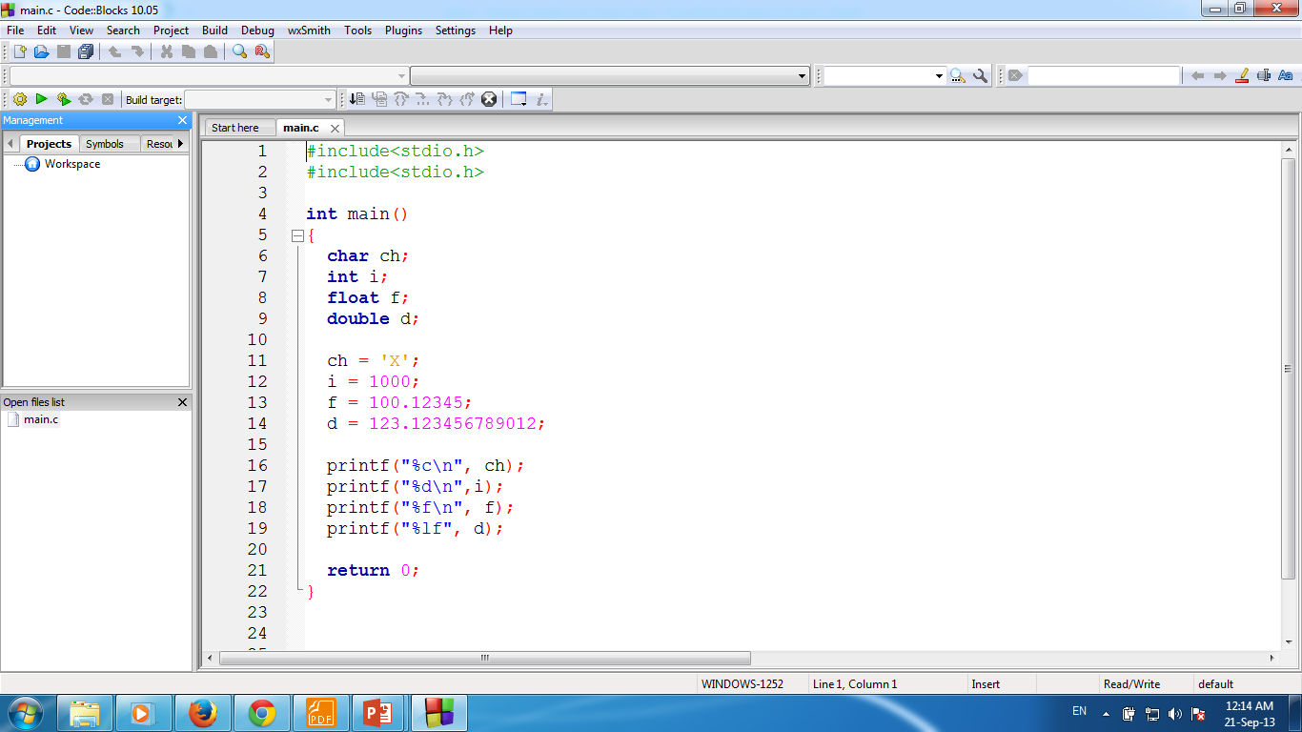
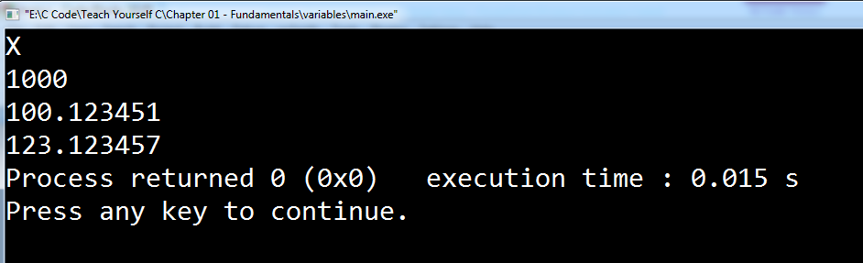

Slide 26
Constants
There are four basic types of constants in C.
integer constants,
floating-point constants,
character constants and
string constants.
There are also enumeration constants
Numeric type constant

Slide 27
Integer Constants
An integer constant is an integer-valued number.
Thus it consists of a sequence of digits.
Integer constants can be written in three different number systems: decimal (base 10), octal (base 8) and hexadecimal (base 16).
Beginning programmers rarely, however, use anything other than decimal integer constants.

Slide 28
Decimal integer constant
A decimal integer constant can consist of any combination of digits taken from the set 0 through 9.
If the constant contains two or more digits, the first digit must be something other than 0.

Slide 29
Integer Constants
Several valid decimal integer constants are shown below.
0 1 743 5280 32767 9999

Slide 30
Integer Constants
The following decimal integer constants are written incorrectly for the reasons stated.
12,245
36.0
10 20 30
123-45-6789
0900
illegal character (, ).
illegal character (.).
illegal character (blank space).
illegal character
the first digit cannot be a zero.

Slide 31
Octal integer constant
An octal integer constant can consist of any combination of digits taken from the set 0 through 7.
However the first digit must be 0,in order to identify the constant as an octal number.
Several valid octal integer constants are shown below.
0 01 0743 077777

Slide 32
Hexadecimal integer constant
A hexadecimal integer constant must begin with either Ox or OX.
It can then be followed by any combination of digits taken from the sets 0 through 9 and A through F (either upper- or lowercase).
Several valid hexadecimal integer constants are shown below.
ox ox1 OX7FFF Oxabcd

Slide 33
Floating-point constant
A floating-point constant is a base-10 number that contains either a decimal point or an exponent (or both).
Several valid floating-point constants are shown below.
0. 1. 0.2 827.602
50000. 0.000743 12.3 315.0066
2 E-8 0.006e-3 1.6667E+8 .12121212e12

Slide 34
Character Constants
A character constant is a single character, enclosed in single quotes.
Several character constants are shown below.
'A' 'X' '3' '?’ ‘ '
Notice that the last constant consists of a blank space, enclosed in apostrophes.

Slide 35
Character Constants
Character constants have integer values that are determined by the computer's particular character set.
Program!
Constant | Value | Constant | Value
'A' | 65 | ‘%’ | 37
‘Z’ | 90 | ‘0' | 48
‘a’ | 97 | ‘ ‘ | 32
‘z’ | 122 | '7' | 55

Slide 36
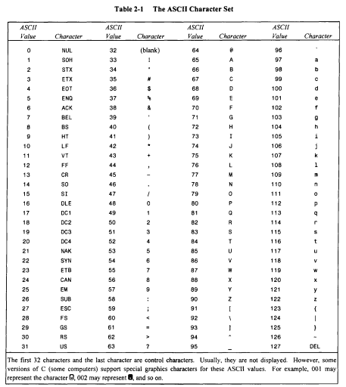

Slide 37
String Constants
A string constant consists of any number of consecutive characters (including none), enclosed in (double) quotation marks.
Several string constants are shown below.
"green" "Washington, D.C. 20005H” "270-32-3456"
"$19.95" "THE CORRECT ANSWER IS:” “2* ( I+3)/J"
“ ” "Line l\nLine 2\nLine 3" “ “

Slide 38
Input Numbers From Keyboard
There are several methods
The easiest is – scanf() function.
Input from Keyboard

Slide 39
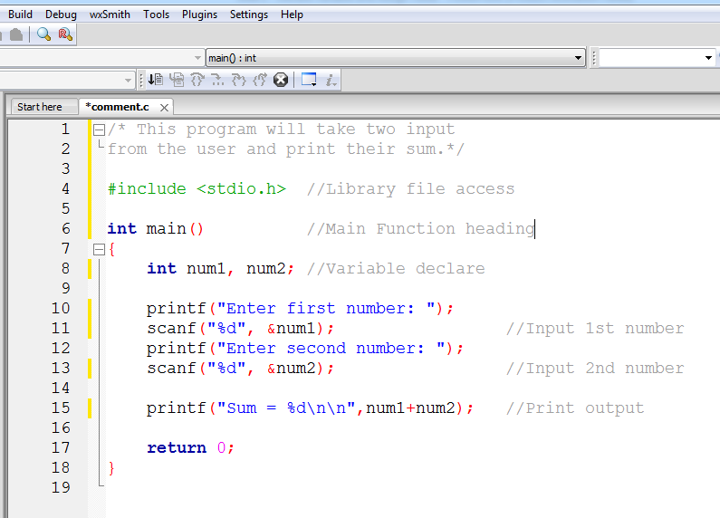

Slide 40
Escape Sequences
There are certain characters in C when they are preceded by a backslash (\) they will have special meaning.
They are used to represent like newline (\n) or tab (\t).

Slide 41
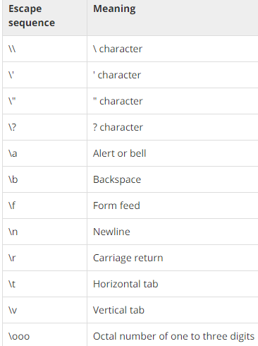
Escape Sequences

Slide 42
Defining Constants
There are two simple ways in C to define constants:
Using #define preprocessor.
Using const keyword.

Slide 43

Using #define preprocessor
Following is the form to use #define preprocessor to define a constant:
Symbolic constants are usually defined at the beginning of a program.
Name of the constant
Can be any valid identifier name
Constant value
Can be character/numeric/string
Notes:
A symbolic constant is a name that substitutes for a sequence of characters.
The characters may represent a numeric constant, a character constant or a string constant.
Thus, a symbolic constant allows a name to appear in place of a numeric constant, a character constant or a string.
When a program is compiled, each occurrence of a symbolic constant is replaced by its corresponding character sequence.

Slide 44





Using #define preprocessor
Notes:
A symbolic constant is a name that substitutes for a sequence of characters.
The characters may represent a numeric constant, a character constant or a string constant.
Thus, a symbolic constant allows a name to appear in place of a numeric constant, a character constant or a string.
When a program is compiled, each occurrence of a symbolic constant is replaced by its corresponding character sequence.

Slide 45

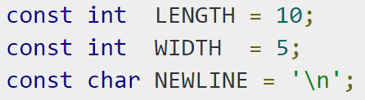
Using const keyword
You can use const prefix to declare constants with a specific type as follows:
Example

Slide 46
Errors!
A C program may have one or more of four types of errors:
Syntax errors (Compiler errors or Compile-time errors)
Linker Errors
Runtime Errors
Semantic Errors
Logic Errors
http://www.cprogramming.com/tutorial/common.html
(Some common programming Errors)

Slide 47
Syntax errors
Syntax errors represent grammar errors in the use of the programming language. Common examples are:
Misspelled variable and function names
Missing semicolons
Unmatched parentheses, square brackets, and curly braces
Using a variable that has not been declared
Incorrect format in selection and loop statements

Slide 48
Linker errors
Linker errors are generated when the linker encounters what looks like a function call; but it cannot find a function with that name.
This is usually caused by misspelling a C standard function (like main) or not including the header file for a function.

Slide 49
Runtime errors
A type of error that occurs during the execution of a program is known as run-time error.
Runtime errors may crash your program when you run it. Runtime errors occur when a program with no syntax errors directs the computer to execute an illegal operation.
Common examples are:
Trying to divide by a variable that contains a value of zero
Trying to open a file that does not exist

Slide 50
Logic errors
Logic errors occur when a programmer implements the algorithm for solving a problem incorrectly. A statement with logical error may produce unexpected and wrong results in the program. Common examples are:
Multiplying when you should be dividing
Adding when you should be subtracting
Opening and using data from the wrong file
Displaying the wrong message
Logic errors are the hardest to find and fix because:
The compiler does not detect these errors
There is no indication of error when the program is executed.
The program may produce correct results for some input data and wrong results for other input data.

